Slide 1

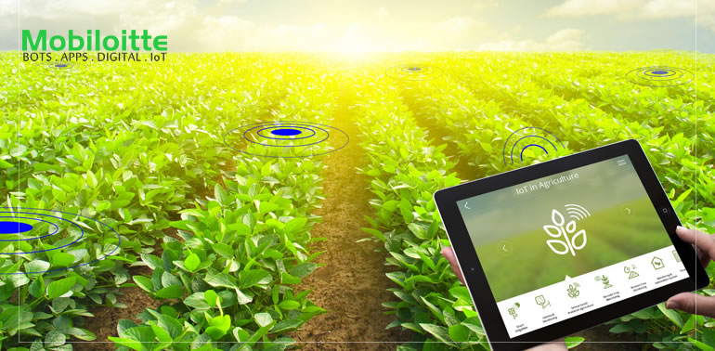
PROGRAMME :DIPLOMA IN COMPUTER SCIENCE & ENGG.
Project Demo On
SMALiv-e
IOT BASED SMART AGRICULTURE AND LIVESTOCK FEEDING MECHANISM
BY,(6th Sem)
DEEPA RANI.B. MAHALAKSHMI.M
SUSHMITHA.A.T. YOGESHWARI.J

Slide 2
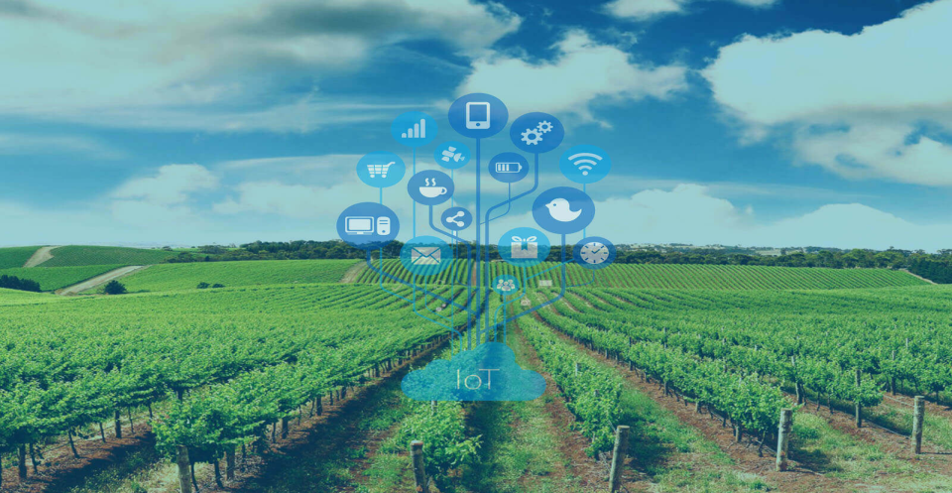
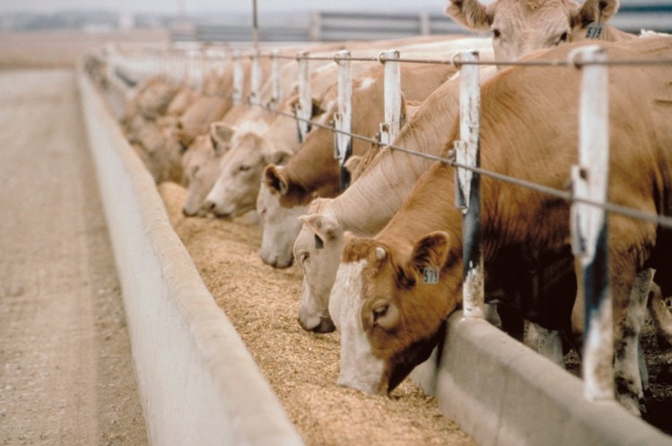
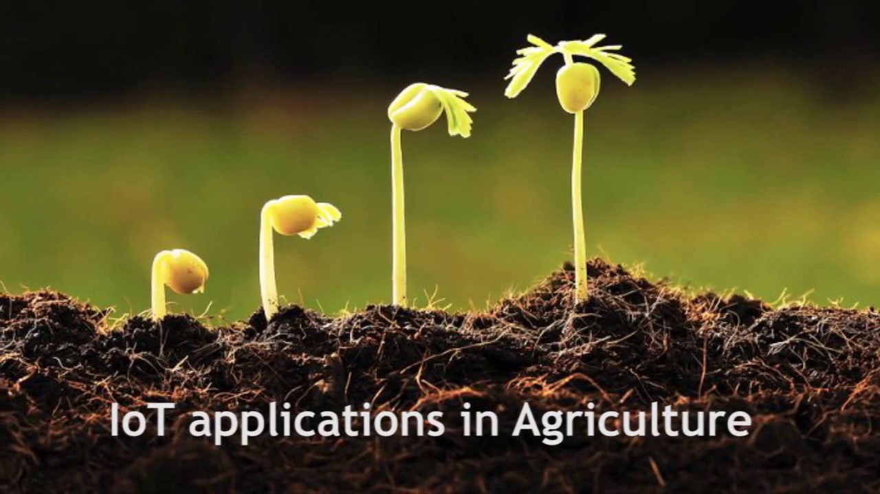
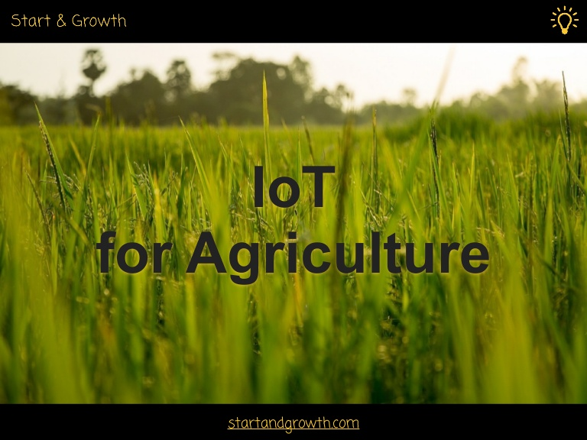
INTRODUCTION

Slide 3
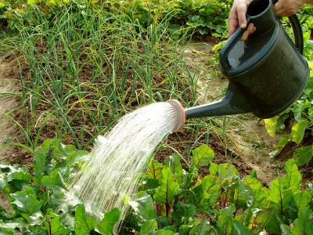
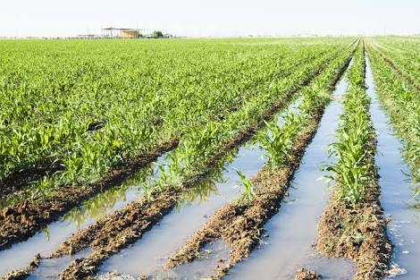
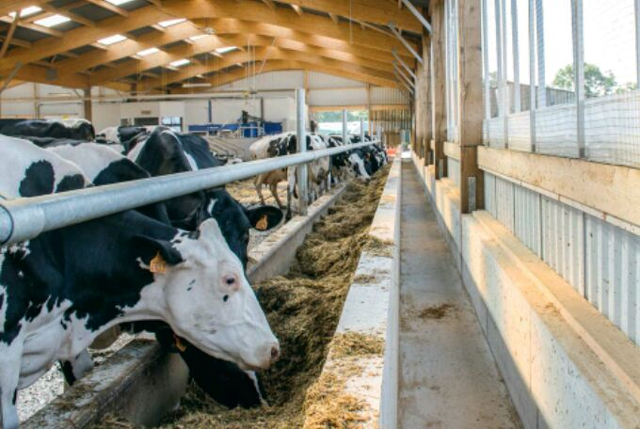
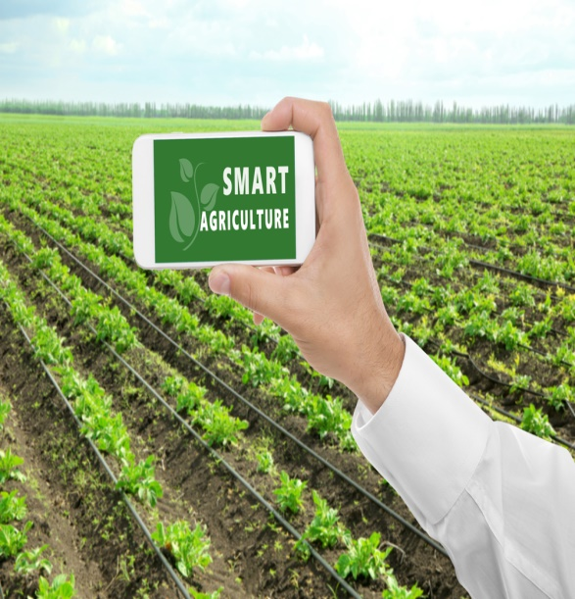
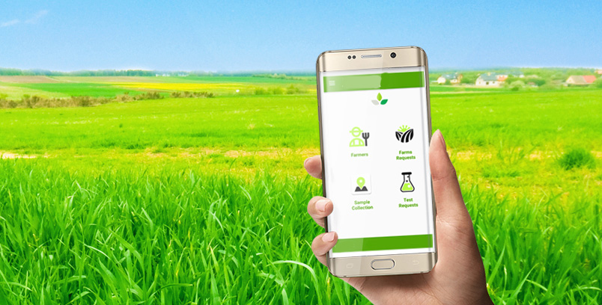
OBJECTIVE OF THE PROJECT

Slide 4

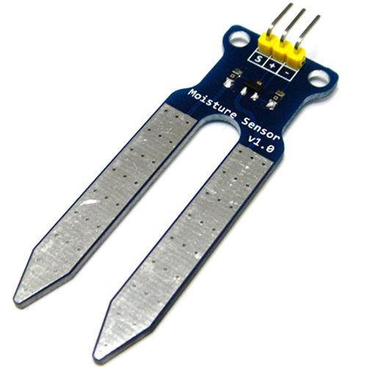
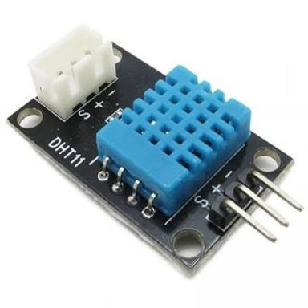
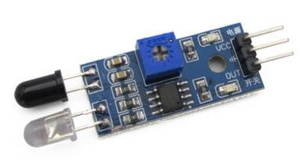
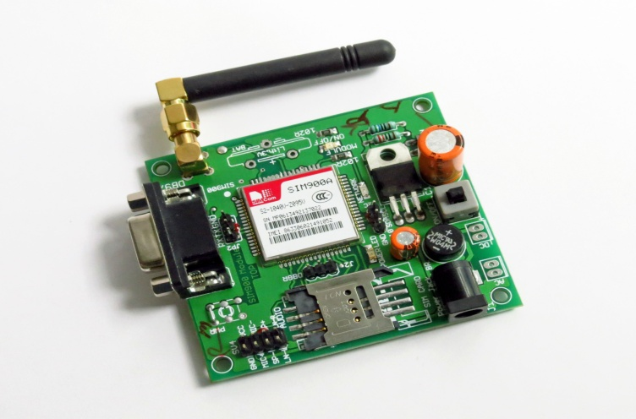
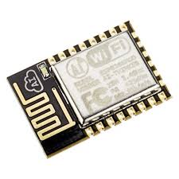
HARDWARES USED
ARDUINO UNO
SOIL MOISTURE SENSOR
TEMPERATURE &
HUMIDITY SENSOR
IR SENSOR
GSM MODULE
Wi-Fi MODULE

Slide 5
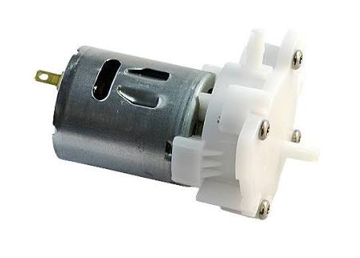
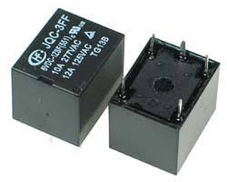
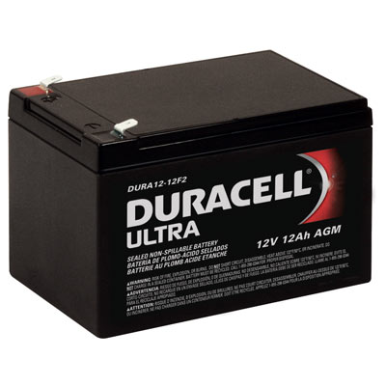
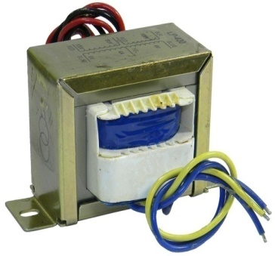
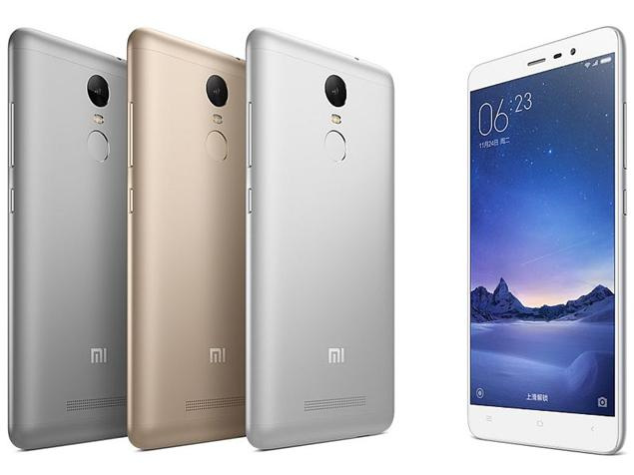
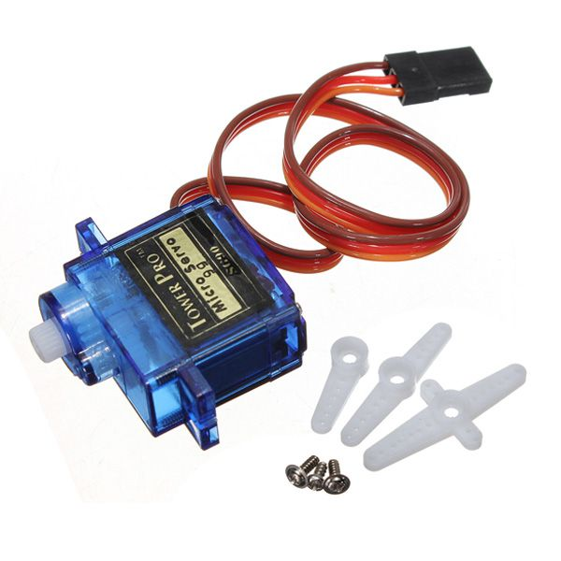
WATER PUMP
RELAY
POWER SUPPLY
SERVO MOTOR
TRANSFORMER
ANDROID DEVICE

Slide 6




SOFTWARE USED
ARDUINO SOFTWARE
FIREBASE DATABASE
LANGUAGE USED
Embedded C
MIT APP INVENTOR TOOL

Slide 7
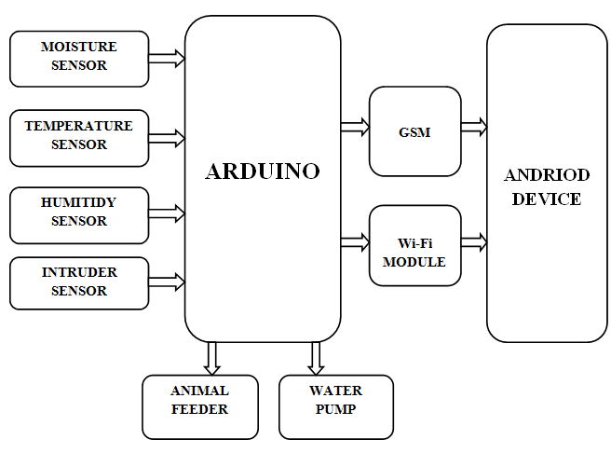
BLOCK DIAGRAM

Slide 8
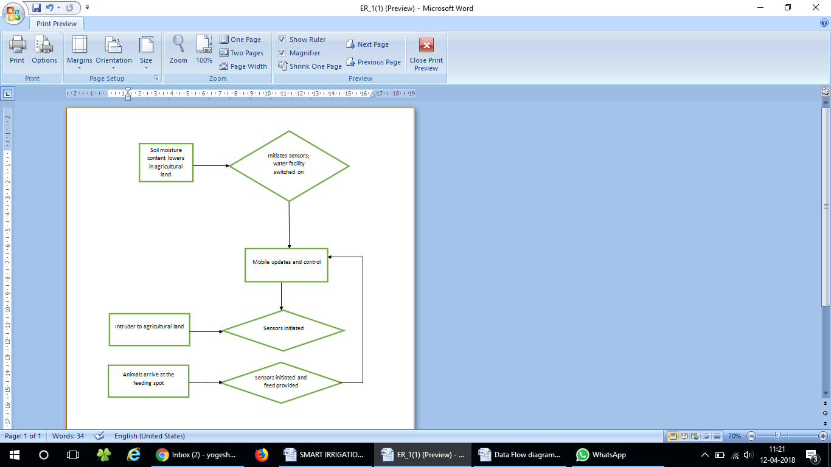
ENTITY-RELATIONSHIP DIAGRAM

Slide 9
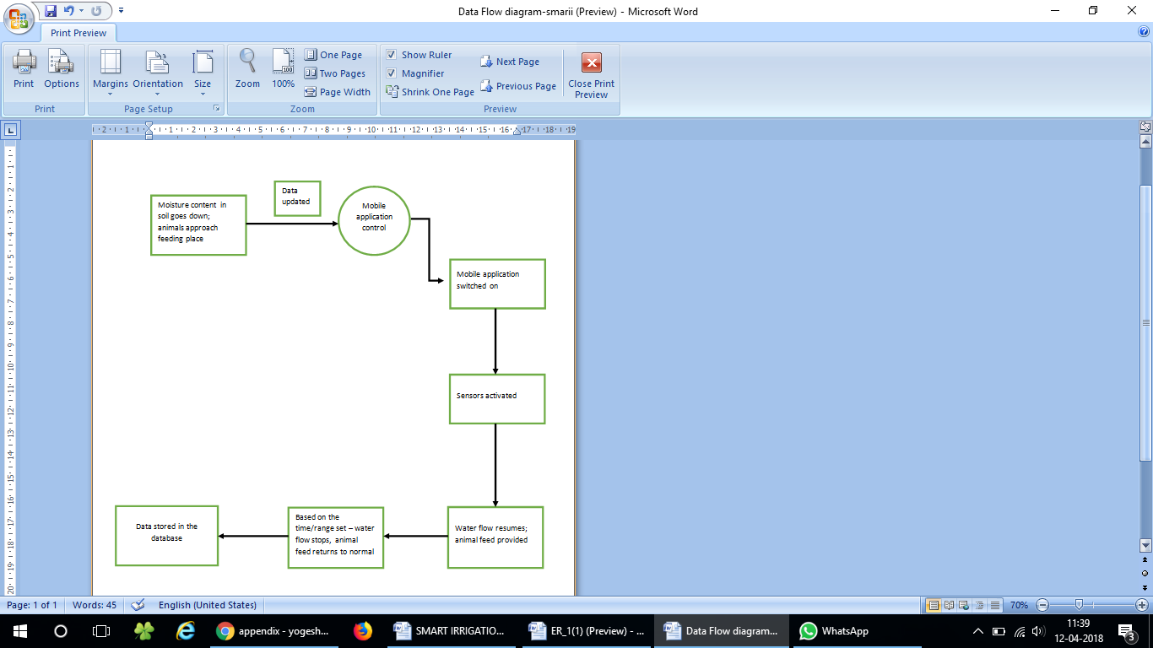
DATA FLOW DIAGRAM

Slide 10
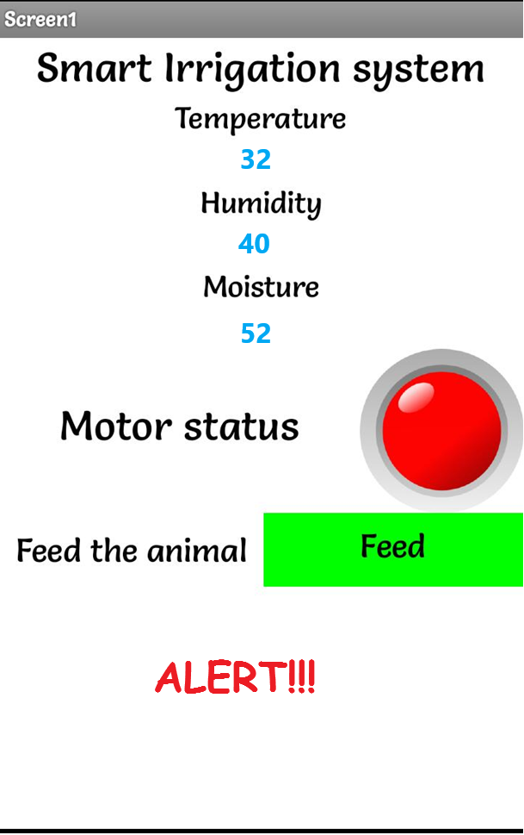
MOBILE APPLICATION SNAPSHOT(OUTPUT SCREEN)

Slide 11
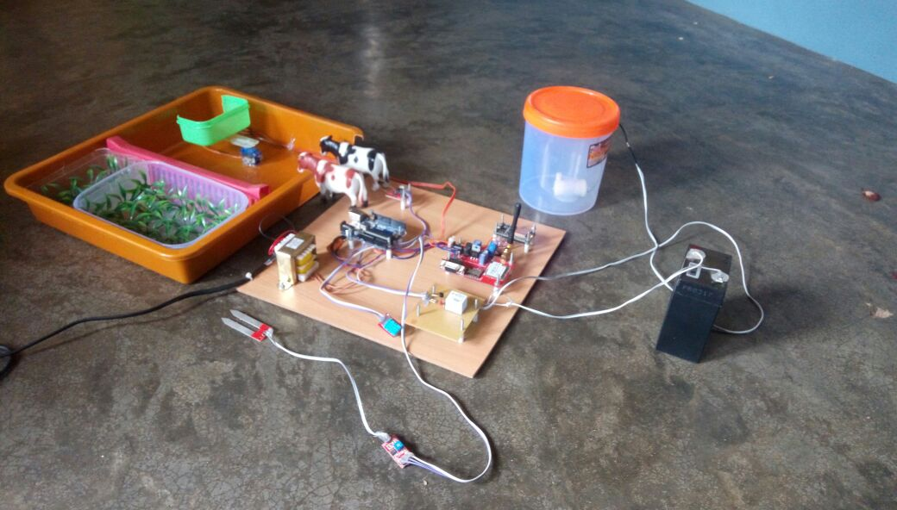
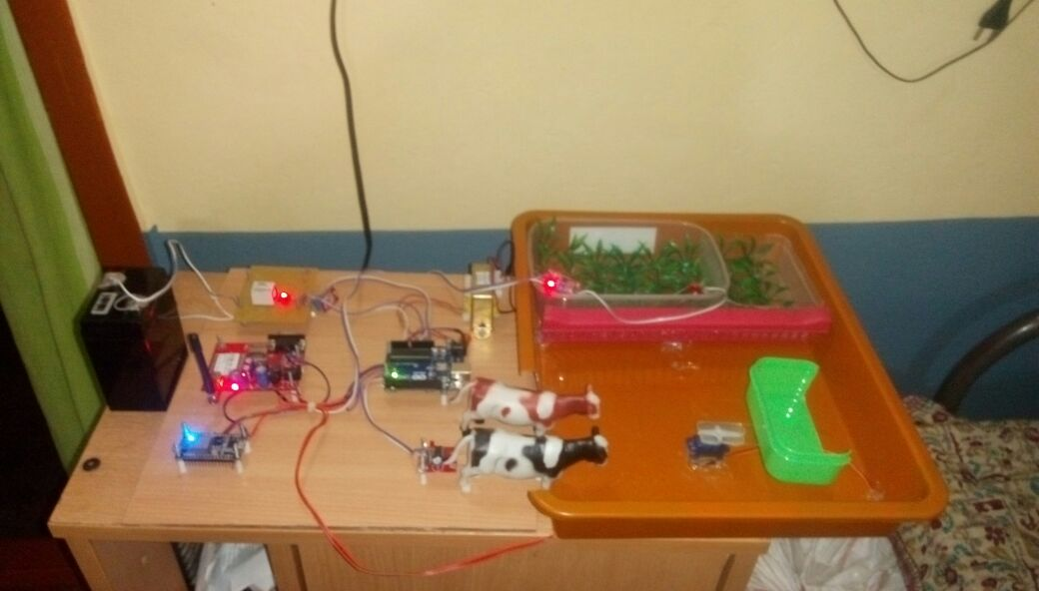
PROJECT SNAPSHOTS

Slide 12
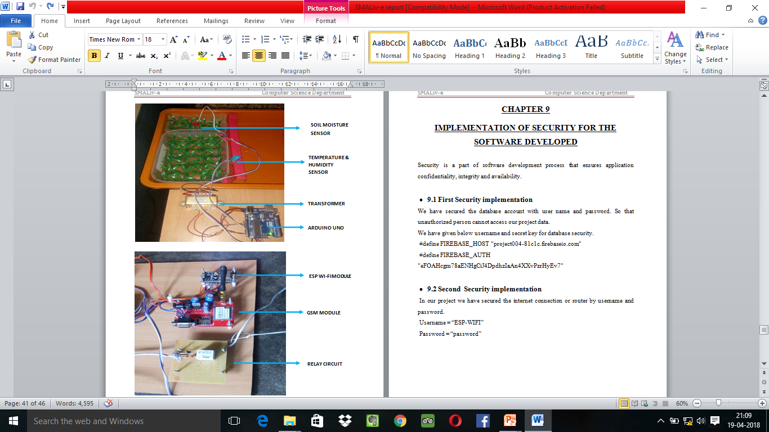

Slide 13
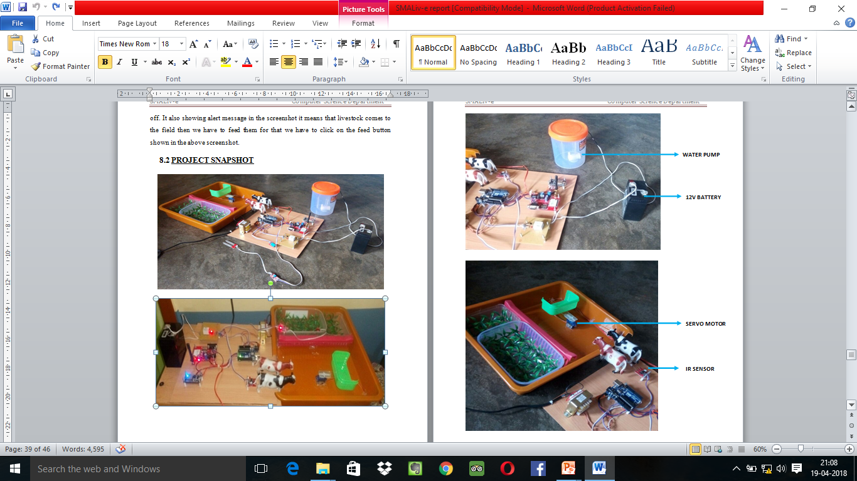

Slide 14
FUTURE SCOPE
A water meter can be installed to estimate the amount of water used for irrigation and thus giving cost estimation.
A solenoid valve can be used for varying the volume of water flow.
Furthermore, Wireless sensors can also be used.
IoT sensors can be used to track an animal’s location, which can be helpful in locating sick animals as well as establishing and optimizing grazing patterns.
Connected sensors in livestock wearables allow farmers to monitor heart rate, blood pressure, respiratory rate, temperature, digestion, and other vitals.
Light sensor is used to detect light intensity of the environment. Light Dependent Resistor (LDR) is used in which the resistivity decreases with increase in light intensity and vice versa.
LDR is used as sensor to turn on and off electric fence or provide artificial lighting for plantation of necessary. Camera is installed for the purpose of image detection when the movement is detected.

Slide 15
Thank You

